Slide 1
Qualification and inclusive employment in the construction industry
“Active employment policies, Pilar of the European Year of Skills”
Good Practices in Response to specific needs and challenges
Javier González López
Head of training and employment
Barcelona,
19th and 20th October 2023

Slide 2
SOME DATA ABOUT WOMEN IN THE CONSTRUCTION
147.337 women
11,1% best data since 2016
+7.711 women workers than 2021
Employment growth 3,5% -> mujeres 5,5%
5.500 women workers in production (3,7%)
Only 0,3% choose VET in construction family
Only 417 womens in basic and mid-grade VET in 2021 – 2022

Slide 3
TRANSFORMING A SOCIAL CHALLENGE IN AN EMPLOYMENT OPORTUNITY
STRUCTURING OF NEEDS DETECTION
BUSINESS ECOSYSTEM
TRAINING CENTRE
UNEMPLOYED WOMEN
Generational replacement
Qualified professionals
Technical skills +
Vocational motivation
Continuous vocational interest
Dual training itinerary
Underrepresentation of women
Business awareness: equal opportunities and Dual VET
Labor market
Selfknowledge
Professional development oportunity
Positive female references
Mentoring
Comprehensive action for the socio-labor insertion of women
In collaboration with:
Notes:
RESPUESTA INCIAIL: Diseño del programa piloto “Construíndo en feminino”, desarrollado en colaboración con la Fundación “La Caixa”, como itinerario prelaboral de entrenamiento grupal de competencias transversales y acompañamiento individualizado, enlazado con el programa de Formación Profesional en Alternancia con el Empleo, dirigido a mujeres jóvenes de 18 a 29 años.

Slide 4
INTEGRATED TRAINING AND EMPLOYMENT ITINERARY
WITH A GENDER PERSPECTIVE
QUALIFIED JOB INSERTION IN THE CONSTRUCTION SECTOR
INDIVIDUALIZED VOCATIONAL GUIDANCE
SOFT SKILLS TRAINING
VOCATIONAL QUALIFICATION
Requirements and employment opportunities.
Positive employees and former students references.
Sector perspective:
Interpersonal: self-knowledge, resilience, self-esteem and adaptation.
Social: communication
Digital
Dual Training
Vocational certificates
Intensive monitoring
Business awareness
Student prospection
Job vacancies prospection
INDIVIDUAL MONITORING
Diagnosis and action plan
Intensive monitoring of Dual training
Job search

Slide 5
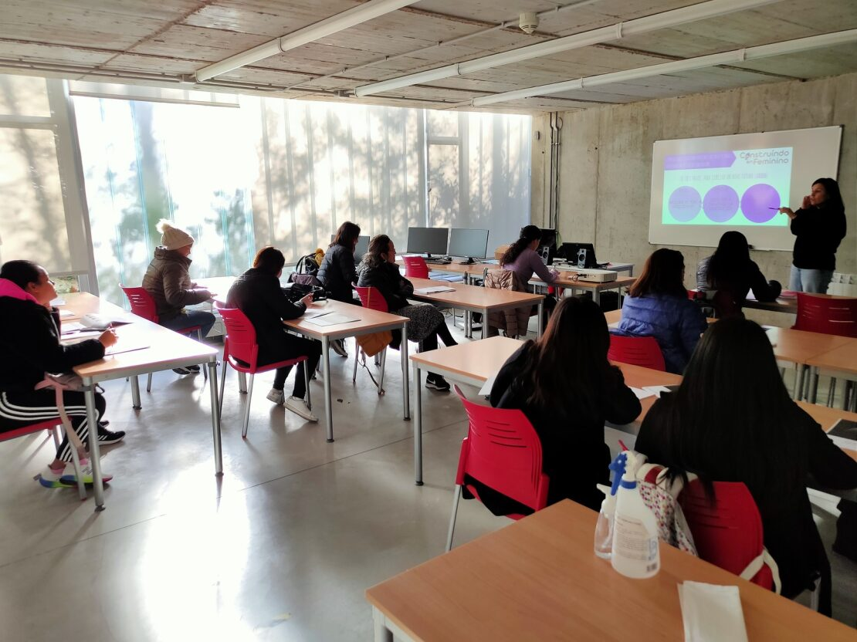
ADAPTED ACTION
INCLUSION PATHWAYS FOR THE ACQUISITION OF SKILLS
CONTINGENCIES
REFORMULATION
Recruitment dificulties18 – 29 years old.
New profiles identification:
Women between 18 and 29 years old with an irregular situation
Women over 30 years old (with a regular/irregular situation)
Derivation from third sector entities and public employment services
Technical reformulation with new itineraries:
Itinerary 1 (18 to 29 years old): Pre-employment skills + Monitoring Dual training
Itinerary 2 (over 30 years old): Pre-employment skills + Vocational certificates
Itinerary 3 (in the process of regularization): Pre-employment skills linked after to itinerary 1 or 2 depending on age

Slide 6
SOCIAL IMPACT
VOCATIONAL REFERENCEES
REFORMULATION
Networking
ROOTING PER TRAINING
Stakeholders dialogue and resources raising
Methodological adaptation
Continuous evaluation of the project cycle
COMPLEMENTARITY
BUSINESS CO-RESPONSIBILITY
USERS DERIVATION
Resource optimization
Complementarity
NETWORKING
26 participants | 12 (46%) Complete itinerary 14 (54%) Pre-work itinerary
10 (38%) training itineraries | 5 (50% ) Dual training 5 (50%) Vocational Certificate SEPE catalogue (construction)
11 (42%) job placements | 7 (63%) construction sector 3 (27%) other sectors
6 (23%) dropouts | Personal reasons
PERSONALIZED MONITORING
DIALOGUE WITH PARTICIPANTS PARTICIPANTING COMPANIES
PUBLIC ADMINISTRATION AGILITY

Slide 7
TOGUETHER, WE BUILD THE FUTURE

